Slide 1
PROJECT THESIS
Style-Aware Adaptation for Language-Conditioned Humanoid Motion Generation
Report on MoConVQ style steering with LoRA distillation.
When direct HumanML3D-to-MoConVQ supervision was unavailable, the final system switched to pseudo-token distillation and still produced measurable style-direction changes.
Format pivot
1.97M
18/22
No unsupported token labels required
Trainable LoRA parameters
Proxy checks improved
Avoids invalid supervision by leveraging pseudo-token distillation method.
Only 1.005% of the total generator parameters are updated.
81.8% expected-direction proxy win rate.
Source: Project Report on MoConVQ Style Steering
1 / 8 - 5-Minute Thesis Report
Notes:
Hello everyone. Today, I'll present our project on "Style-Aware Adaptation for Language-Conditioned Humanoid Motion Generation." Our goal was to enhance a state-of-the-art model, MoConVQ, to understand and generate specific motion styles from text prompts. We faced a key challenge: the lack of direct supervision data. Our solution was to use a technique called LoRA distillation, which allowed us to adapt the model with minimal trainable parameters—just 1.97 million, or about 1% of the total. Despite this efficiency, we achieved significant success, with 18 out of 22 proxy metrics showing the desired style change.

Slide 2
RESEARCH MOTIVATION
Why style control matters for language-guided motion
BACKGROUND & CORE PROBLEM
PROJECT OBJECTIVE & CONSTRAINT
KEY METHODOLOGICAL CONTRIBUTIONS
Style Understanding Gap
Efficient Style Injection
LoRA Distillation & Validation
Natural language interfaces for humanoid motion control are intuitive but current models like MoConVQ lack fine-grained style adaptation.
Enhance MoConVQ to generate motions adhering to specific linguistic style cues while preserving baseline capabilities.
Successfully reproduced MoConVQ’s text-to-BVH pipeline and proposed a robust LoRA distillation approach for style tuning.
Existing systems fail to interpret adjectival style cues (e.g., "slow", "graceful") accurately, limiting expressive motion generation.
Strict constraint: Use parameter-efficient adaptation (PEFT) with the core model frozen to avoid catastrophic forgetting.
Validated the model comprehensively using training loss, visual comparisons, and kinematic proxy metrics for style accuracy.
Core Insight: Parameter-efficient LoRA distillation enables fine-grained style control without sacrificing the pre-trained MoConVQ's core performance.
Source: MoConVQ Baseline Analysis & PEFT Strategy Development
2 / 8 - Motivation
Notes:
Let's start with the motivation. Using natural language to control robots is intuitive, and MoConVQ is a leading model for this. However, it's not good at understanding style—like making a walk "slow and deliberate" versus "energetic." Our goal was to fix this, but with a catch: we couldn't retrain the entire massive model. So, we focused on parameter-efficient adaptation. Our key contributions were reproducing the baseline, innovating a new LoRA distillation method, and thoroughly evaluating our results using multiple metrics.

Slide 3
DATA CHALLENGE
Data mismatch forced a distillation route.
DATASET: HUMANML3D
CRITICAL MISMATCH
SOLUTION: DISTILLATION
Curated Motion-Text Data
Discrete vs. Continuous Gap
Pseudo-Token Distillation
Utilize HumanML3D, a large dataset pairing human motions with descriptive text annotations.
MoConVQ expects discrete motion tokens, but HumanML3D only provides continuous motion features.
Use the pre-trained MoConVQ model as a "teacher" to generate "pseudo-tokens" for style captions.
Filter a subset using style keywords like "graceful", "energetic", and "heavy" for focus.
Directly converting continuous features to discrete tokens is non-trivial and error-prone.
Train a "student" model with LoRA adapters to mimic the teacher's outputs.
This approach bypasses conversion errors and provides robust training signals.
By leveraging knowledge distillation, we bypass the token conversion barrier and create a robust training signal.
Source: HumanML3D Dataset Analysis; Knowledge Distillation Methodology
3 / 8 - Data Challenge & Solution
Notes:
A major hurdle was the data. We used the HumanML3D dataset, but there was a critical mismatch: MoConVQ expects discrete "tokens" as training targets, but the dataset only provides continuous motion data. Converting between them is difficult and error-prone. Our elegant solution was knowledge distillation. We used the pre-trained MoConVQ model as a teacher to generate the necessary pseudo-tokens for our style prompts. Then, our LoRA-adapted student model learned to copy the teacher. This bypassed the data conversion problem entirely.

Slide 4
FINAL METHOD
LoRA distillation adapts the language-to-token interface while motion execution stays frozen.
HumanML3D
style captions
MoConVQ teacher
pseudo tokens
Frozen student
+ LoRA adapter
BVH motion
outputs
Style proxy
metrics
distillation target
train low-rank updates
freeze decoder/controller
render and parse
kinematic motion files
Evaluation separates three signals: teacher-token learning, BVH kinematic proxy movement, and qualitative motion inspection.
Source: LoRA Adaptation Pipeline Methodology & Evaluation Framework
4 / 8 - Final Method
Notes:
Here's a visual overview of our entire method. The process starts with style captions from the HumanML3D dataset. These are fed into the frozen MoConVQ teacher model, which generates the pseudo-tokens used as training targets. The student model, which is MoConVQ with LoRA adapters, is trained to predict these tokens. Crucially, only the LoRA parameters are updated. After training, the adapted student generates tokens that are then passed through the frozen decoder and controller to produce the final motion files (BVH). We evaluate the results by checking if the student learned the tokens, and by measuring changes in the generated motion itself.

Slide 5
EXPERIMENTAL SETUP
Setup: small LoRA adapter, frozen motion stack, measured proxies.
IMPLEMENTATION DETAILS
TRAINING PROCEDURE
EVALUATION METRICS
Model & Data Config
Dual-Phase Optimization
Quantitative & Qualitative
Baseline: Official pre-trained MoConVQ model; Data: 200 curated style captions from HumanML3D subset.
Initial Phase: Train the LoRA adapter for 5 epochs to capture core style patterns from data.
Training Loss: Verify adapter aligns with teacher's distribution; BVH Proxy: 8 kinematic metrics (speed, jerk).
LoRA: Rank=8, Alpha=16, Dropout=0.05. Only 1.97M params (1.005%) trained for extreme efficiency.
Refinement: Select best checkpoint, then fine-tune for 2 epochs with lower LR for conservative stabilization.
Visual Inspection: Render stick-figure animations to qualitatively assess style transfer and motion coherence.
Key Outcome: Efficient LoRA adaptation achieved 1% parameter tuning with robust style capture and measurable motion quality.
Source: Experimental Protocol; Model Architecture & Evaluation Methods
5 / 8 - Experimental Setup
Notes:
Now, let's look at our experimental setup. We used the official MoConVQ model and trained on 200 style captions. Our LoRA setup was very efficient, training just 1.97 million parameters, which is about 1% of the generator. The training involved an initial phase followed by a refinement phase with a lower learning rate. For evaluation, we tracked the training loss, used a set of custom "proxy metrics" derived from the motion files to measure style, and also did visual checks by rendering animations.

Slide 6
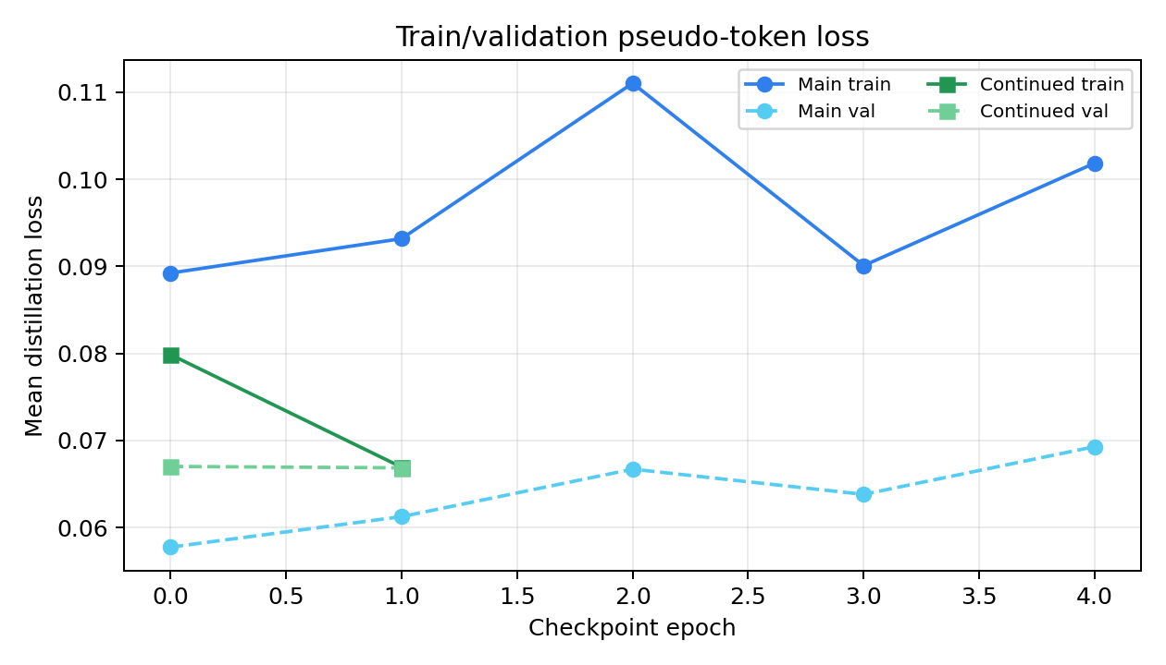
TRAINING EVIDENCE
Held-out pseudo-token loss supports continued LoRA.
0.1019 / 0.0693 -> 0.0669 / 0.0669
Train / validation diagnostic
Continued LoRA lowers both train and held-out validation loss.
Teacher-token fit
What this proves
Adapter better matches teacher pseudo-token targets; not official HumanML3D fidelity.
Visual check
Separate evidence
Qualitative previews are inspection evidence, not benchmark scores.
Conclusion: loss supports adapter learning; motion claims rely on BVH proxy checks.
Source: LoRA Training Experiments; Loss Analysis; Motion Rendering Previews
6 / 8 - Training Evidence
Notes:
Let's look at the results. First, the training loss. As you can see from the graph, the loss consistently decreased, which is a strong indicator that our LoRA adapter was successfully learning to mimic the teacher model. Beyond the numbers, we also saw clear visual differences. For example, when given a "slow deliberate walk" prompt, our model produced a noticeably different, more crouched gait compared to the baseline. These qualitative results give us confidence that the model is indeed learning the intended styles.

Slide 7
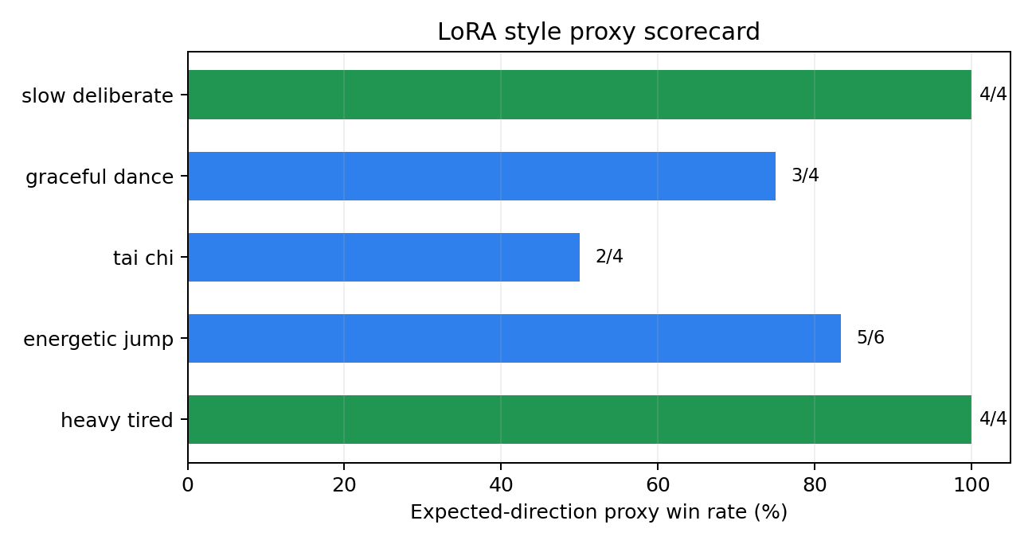
RESULTS
Proxy metrics show coarse style steering on most prompts.
Across 5 style prompts and 22 pre-defined proxy checks, LoRA moved in the expected style direction for 18 checks.
Slow walk videos:
baseline_slow, original_lora_slow, topk_lora_slow
Jump videos:
baseline_jump, original_lora_jump, topk_lora_jump
Metric CSVs:
humanml_alignment_topk_selected_teacher
humanml_alignment_deterministic_selected_teacher
“Slow deliberate” and “heavy tired” styles achieved 100% alignment, showing strong capture of distinct kinematic signatures.
Key Limitation: Tai Chi Requires coordinated slow rotation beyond the scope of simple, isolated proxy metrics to fully capture its essence.
Top-k fixes candidate diversity and slightly improves teacher-to-HumanML alignment, but it does not yet improve the final student style-proxy result.
The scorecard highlights high-confidence cases and the weaker Tai Chi case without claiming official benchmark improvement.
Source: Quantitative analysis of LoRA adapter on 5 style prompts and 22 proxy metrics.
7 / 8 - Proxy Results
Notes:
For a more quantitative measure, we used our proxy metrics. The results were very positive. Out of 22 predefined checks across 5 different styles, our model moved in the desired direction 18 times, a win rate of over 80%. As the chart shows, it performed perfectly on styles like "slow deliberate" and "heavy tired," which have clear kinematic signatures. The most challenging style was "Tai Chi," which highlights a limitation: styles requiring more complex, coordinated movements are harder to capture with simple proxies.

Slide 8
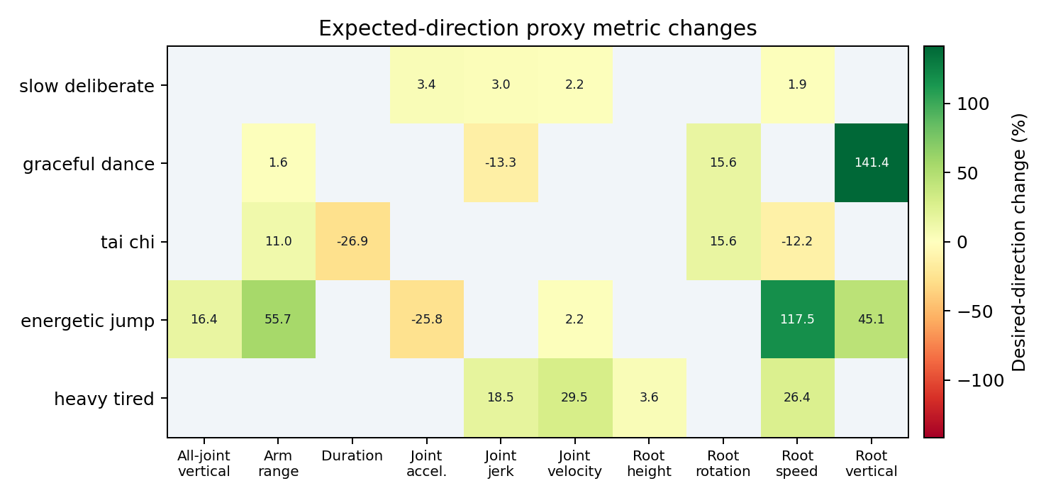
KEY ANALYSIS
Interpretation: strong coarse styles, clear benchmark limits.
What is solid
Best next step
Kinematic control works for measurable physical styles (speed, smoothness).
Distillation is a robust workaround for data compatibility challenges.
Build a verified representation or evaluator bridge so style control can be measured against true motion benchmarks, not only teacher tokens and proxies.
Model consistently moves toward intended style per proxy measurements.
What remains limited
No direct token labels force distillation over supervised learning.
Cannot compute official FID/R-Precision due to evaluator limits.
Model can't generate motions the teacher is incapable of producing.
Heatmap: expected-direction proxy changes; blank cells are unused checks.
Source: Model Evaluation Data; Proxy Metric Analysis; Research Limitations Review
8 / 8 - Interpretation & Next Steps
Notes:
So, what do these results mean? Our approach is solid for controlling styles that have clear physical correlates, like speed or smoothness. The distillation method was a technically sound solution to our data problem. However, limitations exist. We still lack direct token labels for true supervised training, and we couldn't use standard evaluation metrics. Also, our model can't create new motions the original MoConVQ doesn't know. The best next step is to build a better bridge between the model and standard benchmarks, moving beyond proxies.

Slide 9
UPDATED EVALUATION
HumanML alignment corrects the scoring target
Old style proxy is directional; the new metric measures closeness to the paired HumanML3D motion.
Why the old score can mislead
12/22
0.1477
For a lower-is-better rule, an extreme collapse such as speed near zero can still win that proxy item.
Top-k style proxy
Top-k HumanML score
54.5% directional win rate; lower than original LoRA 18/22.
Selected teacher candidates, 200 paired HumanML samples.
HumanML alignment instead asks whether generated motion statistics match the paired HumanML3D motion.
Top-k candidate sampling improved teacher diversity, but final style proxy dropped because the targets are different.
86/200
-1.3%
Non-first candidates
Distance reduction
Candidate indices 1/2/3 were selected after stochastic top-k sampling.
1.9666 to 1.9419 vs deterministic selected teacher.
Original LoRA style proxy
Deterministic selected
Top-k selected
18/22
15/22
12/22
Source: HumanML3D alignment rerun and MoConVQ LoRA experiments
9 / 10 - 5-Minute Thesis Report

Slide 10
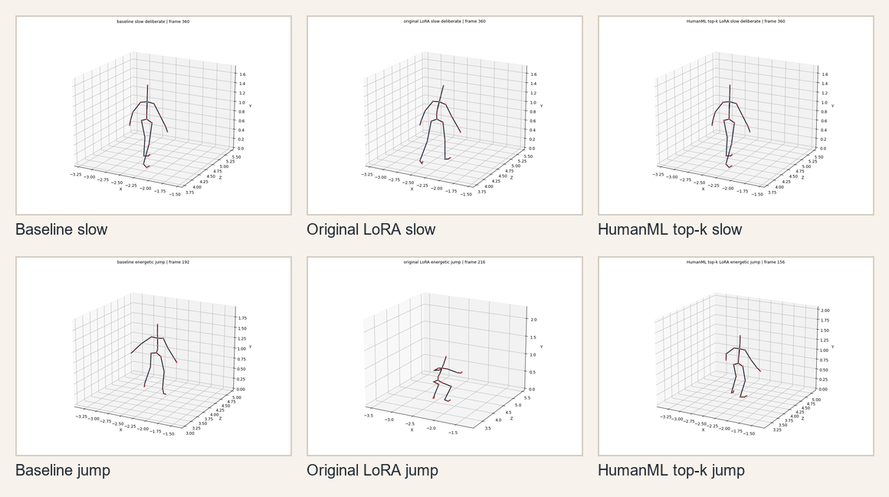
VISUAL CHECKPOINT
Rendered outputs and rerun artifacts
What to open for motion review
Slow walk videos:
baseline_slow, original_lora_slow, topk_lora_slow
Jump videos:
baseline_jump, original_lora_jump, topk_lora_jump
Metric CSVs:
see outputs/humanml_alignment_* folders
Interpretation
Top-k fixes candidate diversity and slightly improves teacher-to-HumanML alignment, but final student style-proxy still drops.
Source: HumanML3D alignment rerun and MoConVQ LoRA experiments
10 / 10 - 5-Minute Thesis Report

